Slide 1
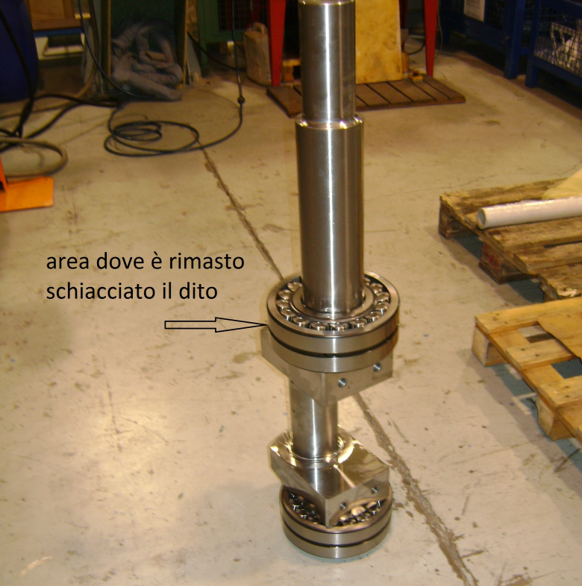
HS&E INCIDENT BULLETIN |  | 2nd half year 2017
Location Country: Italy | Type of incident : crush of a finger
Summary:
An operator, that was wearing PPE, after having heated a roller bearing (approximate weight 15 kg) on the induction oven, inserted it on a crankshaft, positioned vertically to make easy the assembly. The roller bearing slipped fastly in the seat of the crankshaft while the operator was still keeping it in his hands, crushing a finger of his right hand.
Root Causes: | Actions Taken Thus Far: Next Steps
Non automatic roller bearings assembly (totally assigned to manual skills of the operator); Inadequate procedure used to assembly the roller bearings after heating operations | build a structure to position crankshafts horizontally, increasing the stability of the components and reducing the risk of falling during the roller bearing assembly phase; evaluate an alternative procedure to insert roller bearings on the crankshafts, using dedicated equipment in order to eliminate crush risk

